Slide 1
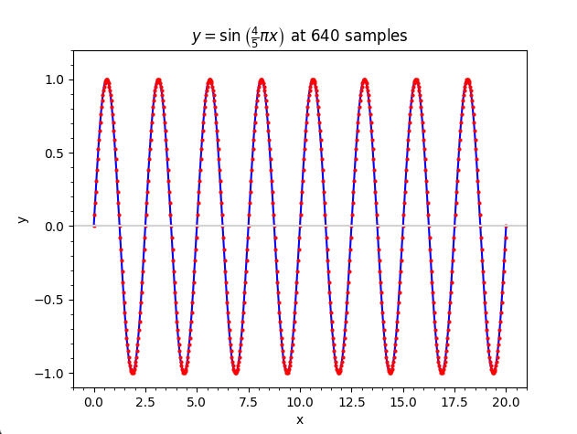
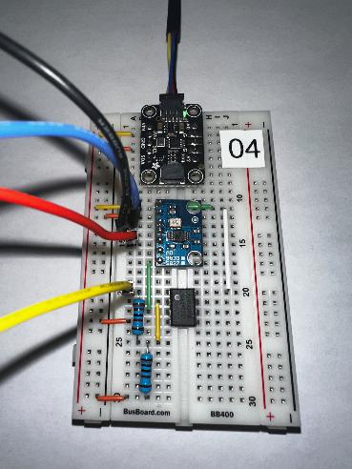
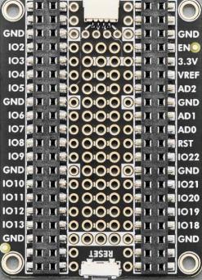
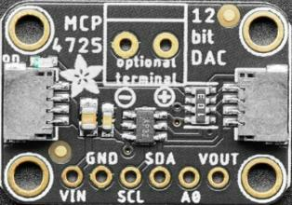
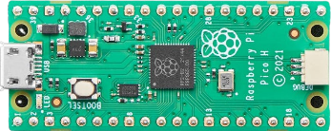
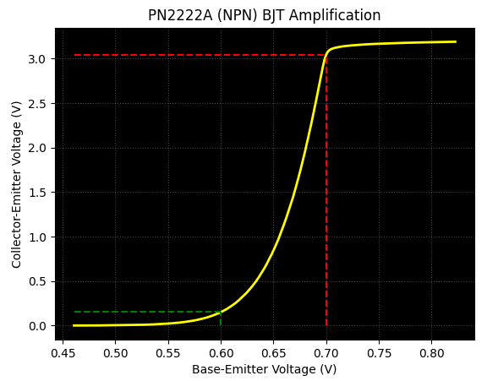

Control System Electronics 101
Using Python and Sensors to Measure Circuits
Board 01
CircuitPython, GPIO, NeoPixels, RC Circuit
Dave Biersach
dbiersach@bnl.gov

Slide 2





Welcome!
My name is Dave Biersach
I am a Senior Technology Architect at BNL
I am a 1989 graduate of the United States Military Academy at West Point, and I served in the Persian Gulf War as a Combat Engineer
I developed satellite counter-reconnaissance search algorithms while working for DARPA
I have worked at Microsoft & Pfizer
I have been married for 35 years, have three adult children, two dogs, and have sponsored interns for the past 17 years

Slide 3
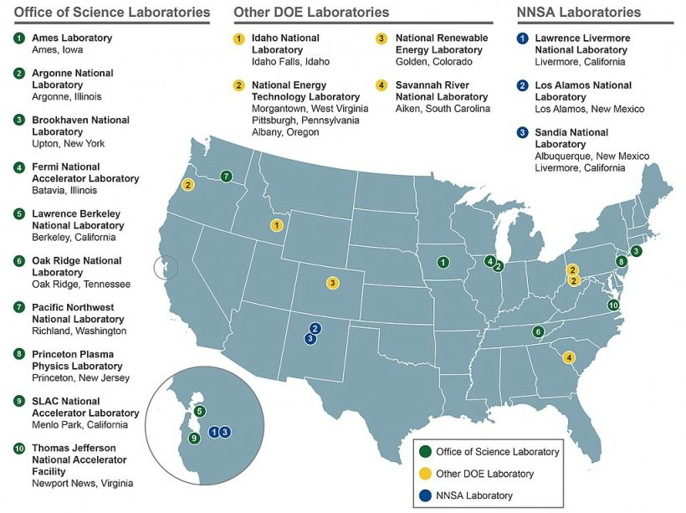
The US Department of Energy
National Nuclear
Safety Administration
17 National Labs across the USA
Student research opportunities exist at all US Labs

Slide 4

https://www.bnl.gov

Slide 5

About Brookhaven National Laboratory
YouTube - This is Brookhaven Lab

Slide 6
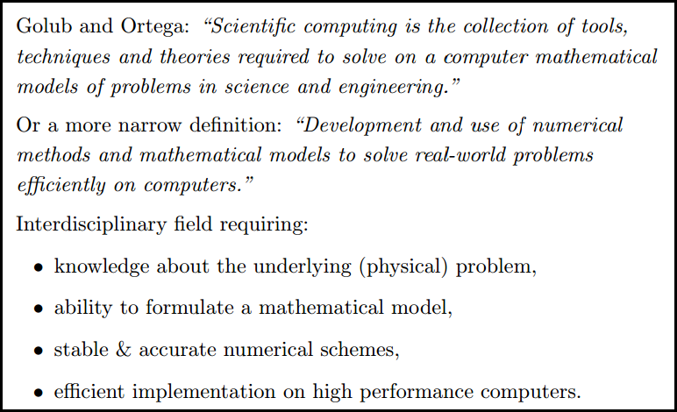
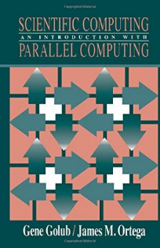
What is Scientific Computing?

Slide 7
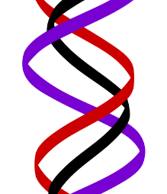
What is Scientific Computing?
Scientific computing problems cannot be solved using just a graphing calculator or a spreadsheet program
A computer should not be viewed as just another closed-form benchtop instrument with fixed functionality
SciComp does not require writing thousands of lines of code to answer problems – complete code usually fits on one slide!
SciComp is applied computer science
The first name of CompSci is computer
The first name of SciComp is science
A triple helix of math, science, and computing

Slide 8
SciComp vs CompSci
Scientific Computing
Computer Science
Probability and Statistics
Simulation and Modelling
Data Visualization
Storing and Analyzing Very Large Datasets
Parallel & Distributed Algorithms
Speed and Accuracy Paramount
Functional Languages
Open-Ended Problems with Unknown Solutions
General Data Structures
Design Methodologies
Procedural Languages
Stand-Alone Programs
Emphasis on Object-Orientation
Simple Data Models
Sequential Algorithms
Less Graphics Intensive
Directed Closed-Form Problems with Known Solutions

Slide 9
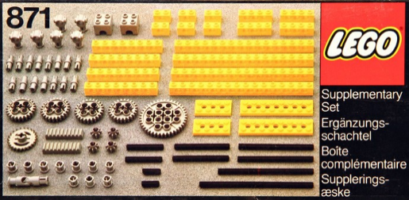
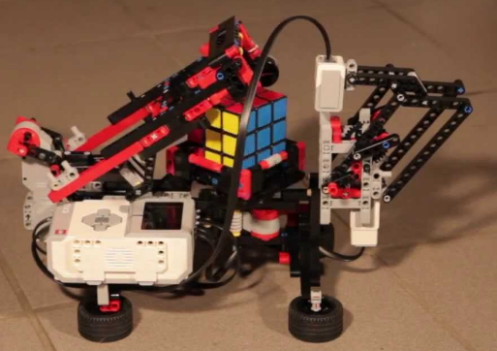
SciComp = Just Enough CompSci
Data types: int, float, bool, string
Data structures: lists, arrays, dictionaries, classes, modules
Functions: def, return
Statements: if, for, while, break
Patterns: vectorization, divide & conquer, map-reduce
Algorithms: GCD, mean/variance, sorting, searching
Modules: numpy, matplotlib, numba, scipy, sympy, scikit-learn

Slide 10
Scientific Computing with Python
Python is quickly becoming one of the most heavily used languages in science projects
Python runs on all major modern operating systems and is completely free and open-source (not vendor-controlled)
Python makes it easy for your code to directly integrate with a large spectrum of available 3rd party software
Python code runs consistently on different platforms and scales well from small IoT devices to large server clusters
Python benefits from a very active and growing user community that continues to enhance the language
200,000+ free/open-source packages are readily available!

Slide 11
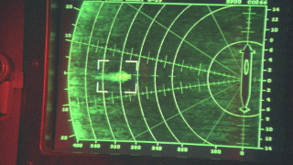
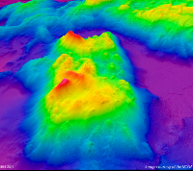


Example SciComp Topic Multidimensional Interpolation
YouTube - Jonsey Reports

Slide 12


Example SciComp Topic Multidimensional Interpolation
Modi (Brave) and Magni (Strong)

Slide 13
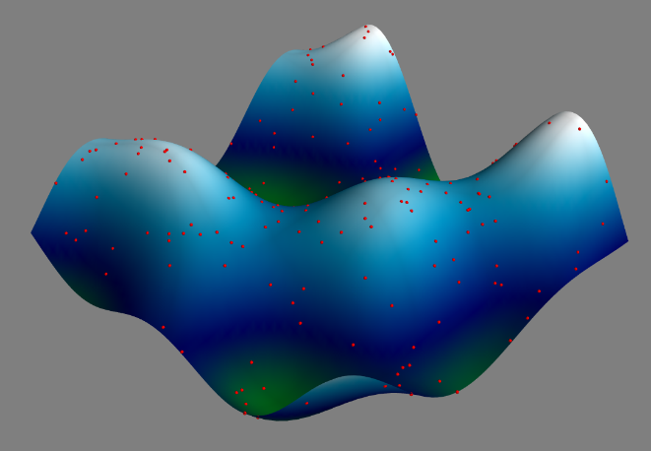
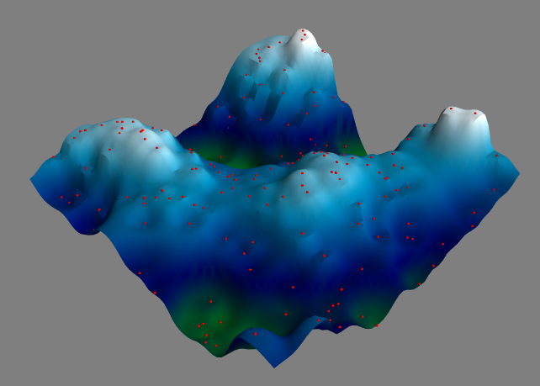
Example SciComp Topic Multidimensional Interpolation
A first order 3-D approximation of the ocean floor based upon only 220 sample (red) points (sonar timings)

Slide 14
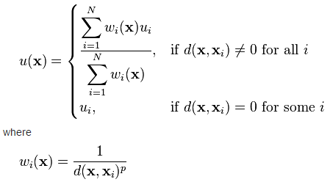
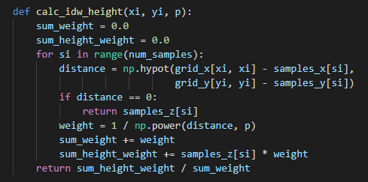
SciComp As Translational Science
"The algorithm that almost won the cold war"
11 lines of code can change the world!
SciComp is the ability to translate mathematical expressions of scientific concepts into correct and efficient software code

Slide 15
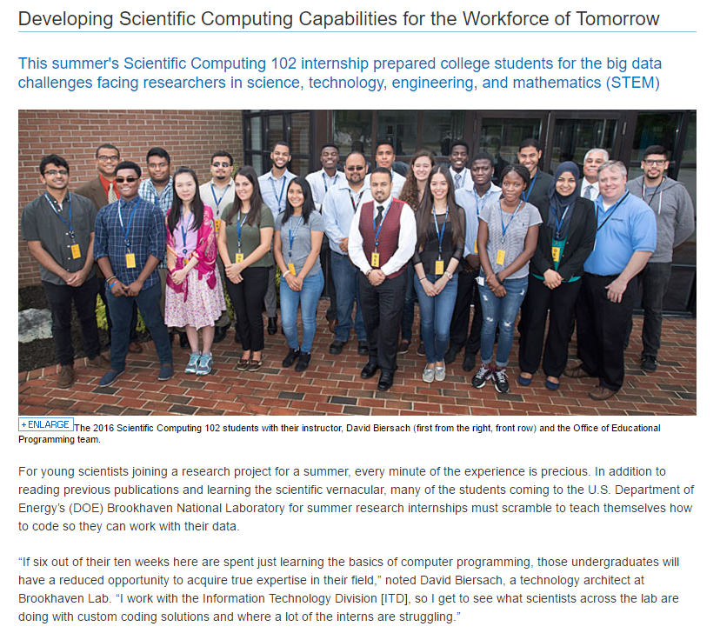
https://www.bnl.gov/newsroom/news.php?a=26599

Slide 16

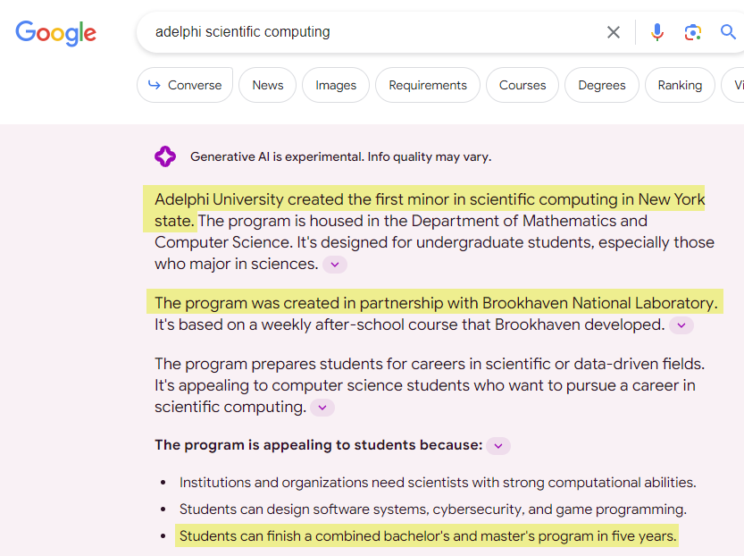
https://www.bnl.gov/newsroom/news.php?a=213064

Slide 17
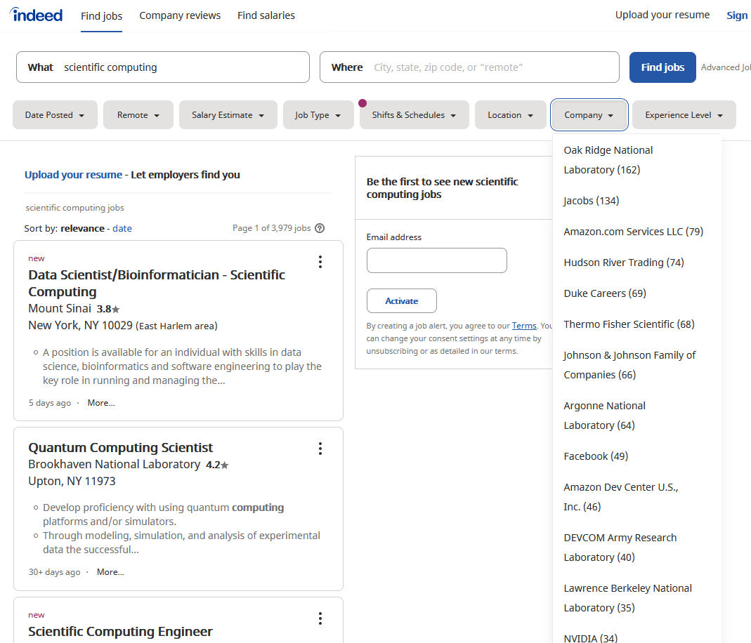
SciComp = The Pathway to Internships

Slide 18
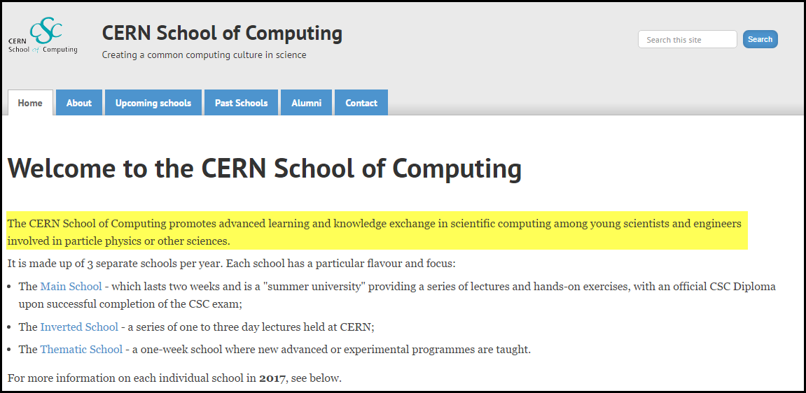
SciComp = The Pathway to Internships
High school interns at CERN are required to complete a course in Scientific Computing before they can begin their internship.
That is how important CERN views these skills!

Slide 19
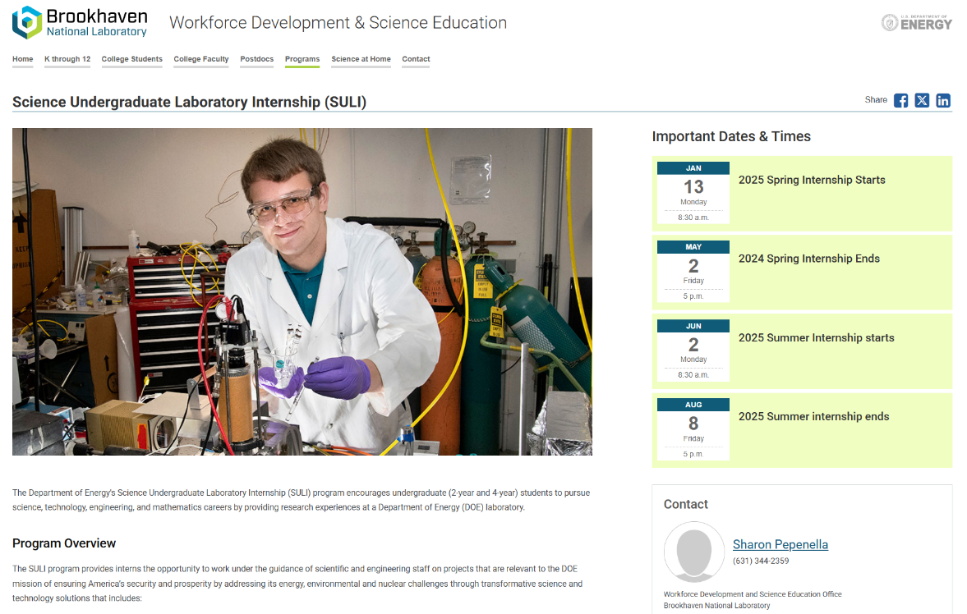
BNL Science Undergraduate Laboratory Internship (SULI)
https://www.bnl.gov/education/programs/program.php?q=188

Slide 20

About BNL's College Internships
YouTube - Summer Internship Programs at Brookhaven Lab

Slide 21
Control Systems Engineering
Modern science is critically dependent on the precision and reliability of control systems built and maintained by engineers and technicians
This hands-on workshop will teach the fundamentals of programming microcontrollers to automate the acquisition and analysis of experimental data measured from analog and semiconductor circuits
You will write Python code to control high-precision sensors that can rapidly measure and plot the transient reactions of various electronic components
These skills are precisely what the US Department of Energy is looking for across all 17 National Laboratories!

Slide 22
2026 Mini-Semester (Tech/Engr Track)

Slide 23
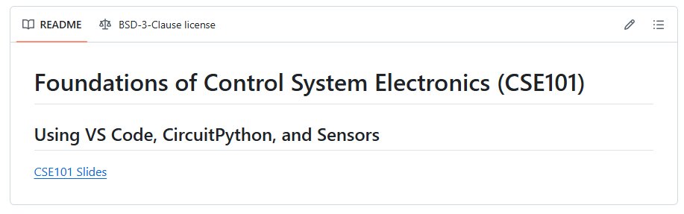
Download the CSE101 Courseware
The CSE101 courseware is in a GitHub repository here:
https://github.com/dbiersach/cse101
The bottom of that page has a link to the slides:
①
②

Slide 24
Download the CSE101 Courseware
The CSE101 course uses three open-source (and free $$$) tools: git, uv, and VS Code
The next few slides show how to install these tools using WinGet (for Windows) or Homebrew (for macOS)
If you cannot use WinGet or Homebrew on your PC, manual installation instructions are on the slides at the end
If you have these three tools already installed on your PC, you do not need to reinstall them
Ensure all three are updated to the latest version
Be sure you can launch git, uv, and code from a terminal session on your PC

Slide 25
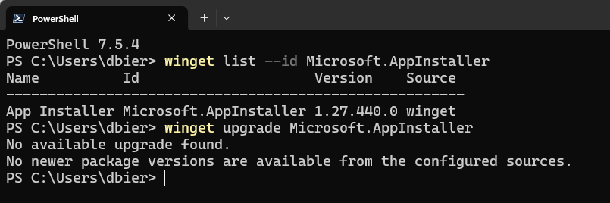
(Windows) Step 0 – Update winget
Start a Windows Terminal session, then enter these commands:
winget list --id Microsoft.AppInstaller
winget upgrade Microsoft.AppInstaller
①
②
https://learn.microsoft.com/en-us/windows/package-manager/winget

Slide 26
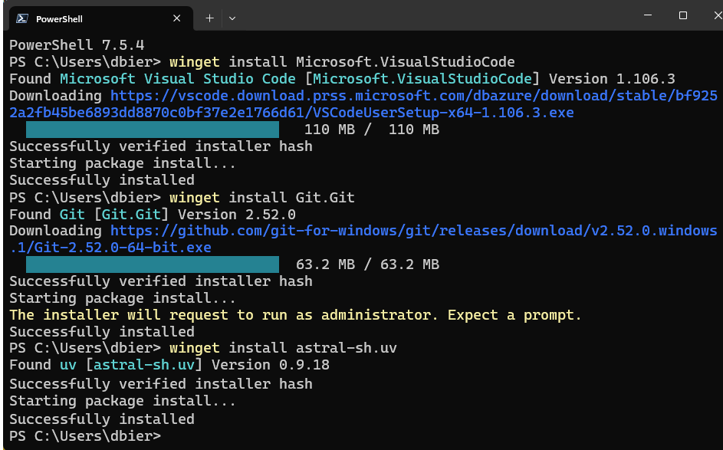
(Windows) Step 1 – Install Tools
winget install Microsoft.VisualStudioCode
winget install Git.Git
winget install astral-sh.uv

Slide 27
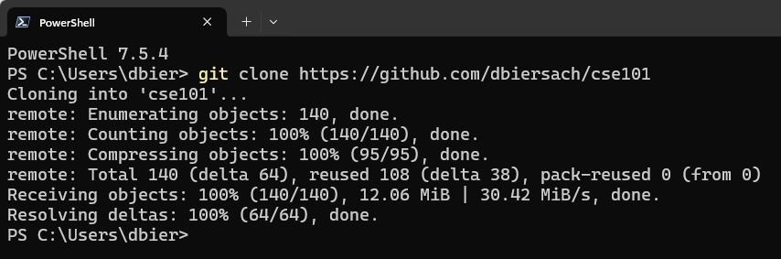
(Windows) Step 2 – Install Courseware
Start a new Windows Terminal session, then enter these five commands:
git clone https://github.com/dbiersach/cse101
cd cse101
.\install_vscode_extensions.ps1
uv sync
code .\cse101.code-workspace

Slide 28
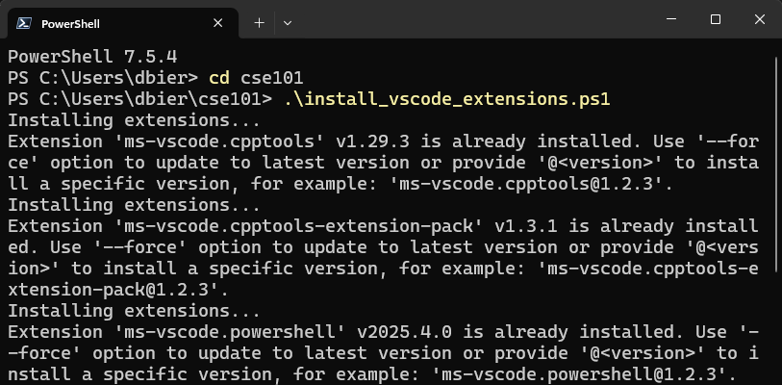
(Windows) Step 2 – continued

Slide 29
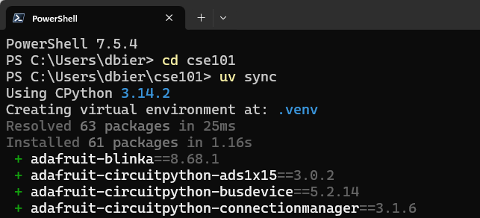
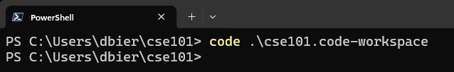
(Windows) Step 2 – continued

Slide 30
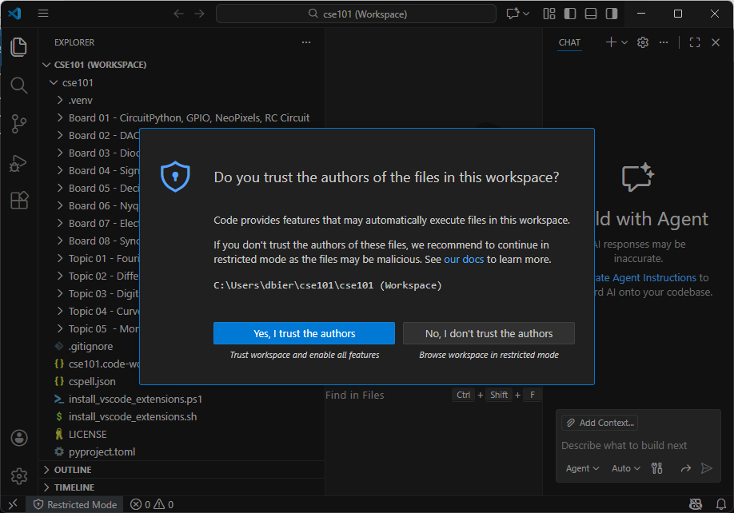
(Windows) Step 3 – Trust the Workspace

Slide 31
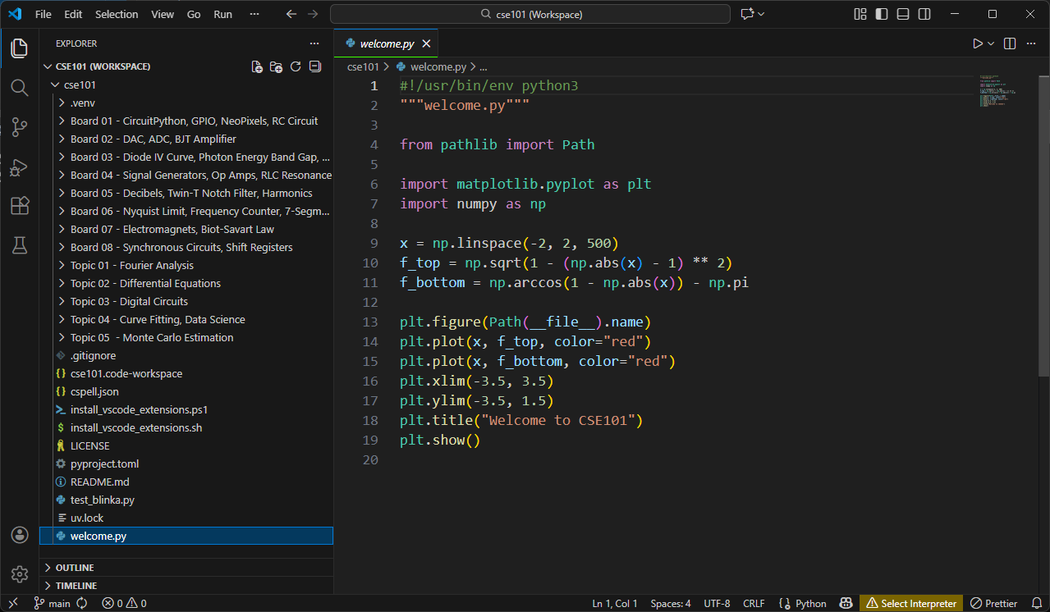
(Windows) Step 4 – Open welcome.py

Slide 32
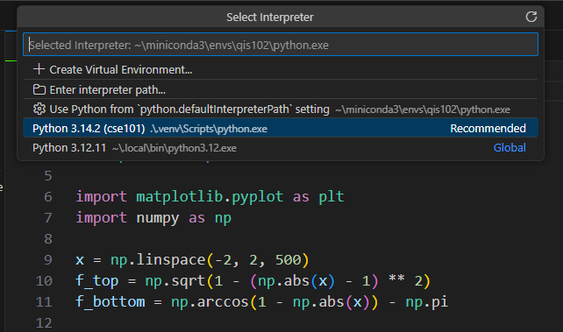
(Windows) Step 5 – Select Interpreter

Slide 33
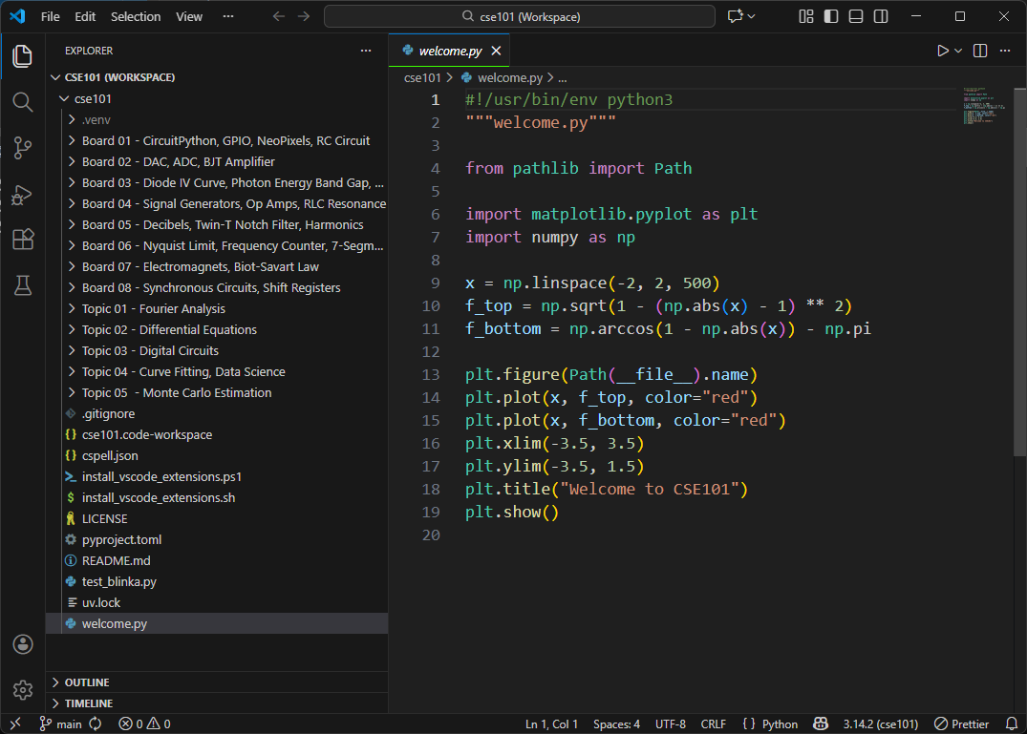
(Windows) Step 6 – Run welcome.py

Slide 34
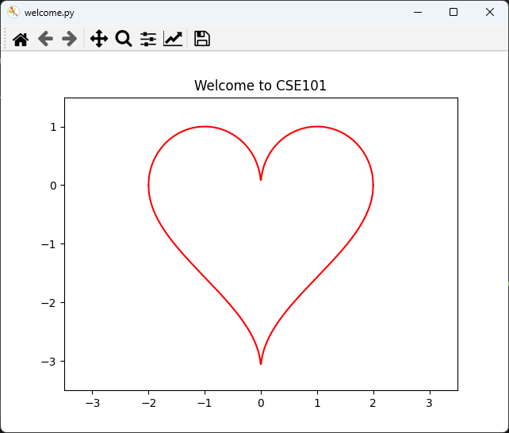
(Windows) Step 6 – continued

Slide 35
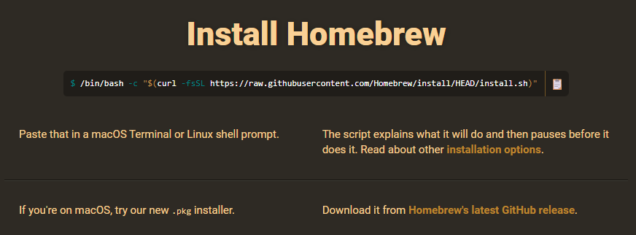
(macOS) Step 0 – Install Homebrew
Only do this if you do not already have Homebrew installed on your Mac…
https://github.com/Homebrew/brew/releases/download/5.0.8/Homebrew-5.0.8.pkg

Slide 36
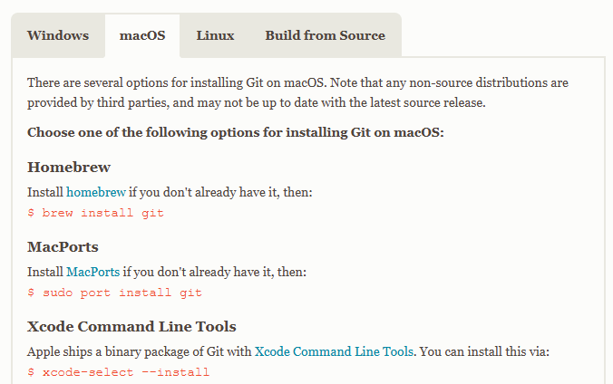
(macOS) Step 1 – Install Git
In a new Terminal window…
brew install git

Slide 37
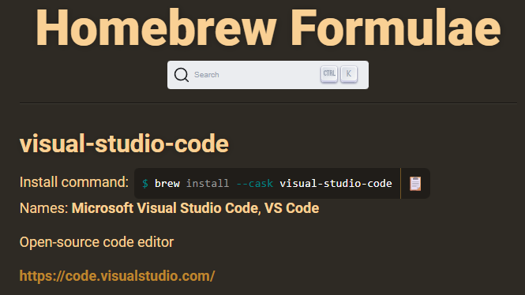
(macOS) Step 2 – Install VS Code
In the same Terminal window…
brew install --cask visual-studio-code

Slide 38
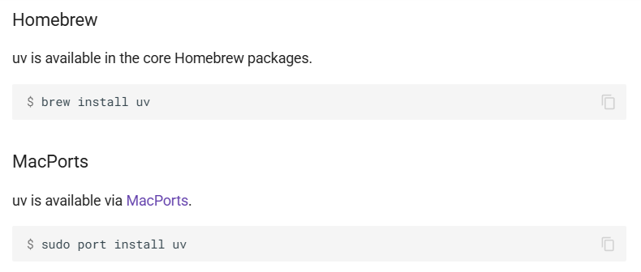
(macOS) Step 3 – Install Astral “uv”
In the same Terminal window…
brew install uv
https://docs.astral.sh/uv/getting-started

Slide 39
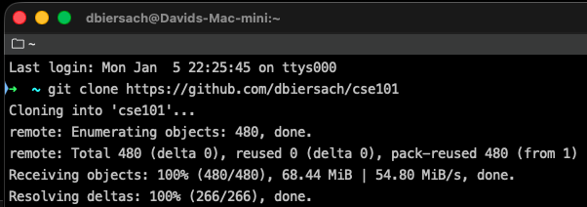
(macOS) Step 4 – Clone the CSE101 Repo
In a new Terminal window…
git clone https://github.com/dbiersach/cse101

Slide 40
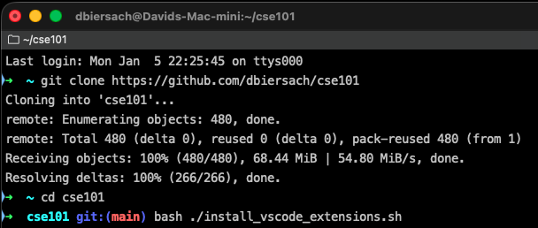
(macOS) Step 5 – Install VS Code Extensions
In the same Terminal window…
cd cse101
bash ./install_vscode_extensions.sh

Slide 41
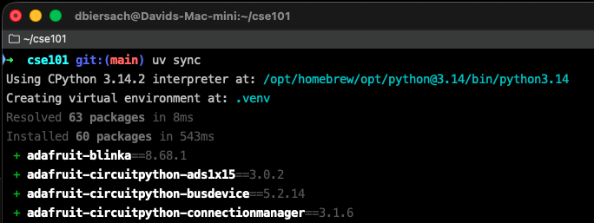
(macOS) Step 6 – Create Python .venv
In the same Terminal window…
uv sync

Slide 42
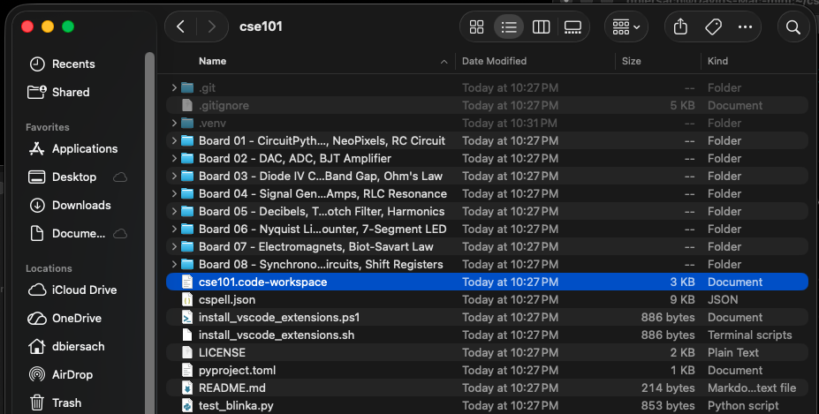
(macOS) Step 7 – Open the Workspace

Slide 43
(macOS) Step 8 – Trust the Workspace

Slide 44
(macOS) Step 9 – Open welcome.py

Slide 45
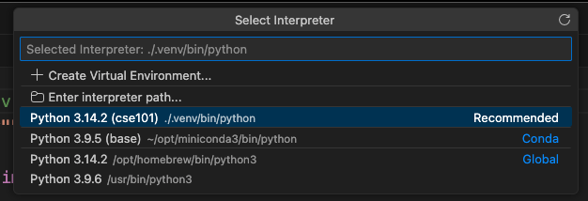
(macOS) Step 10 – Select Interpreter

Slide 46
(macOS) Step 11 – Run welcome.py

Slide 47
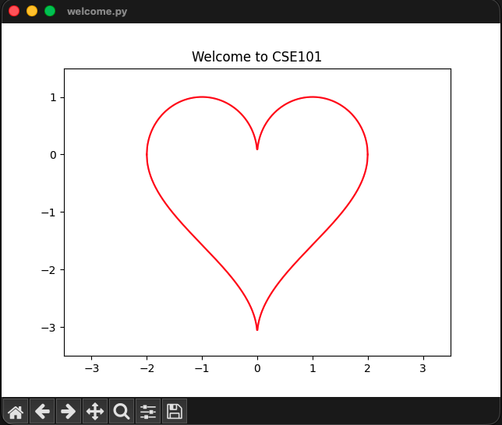
(macOS) Step 11 – continued

Slide 48
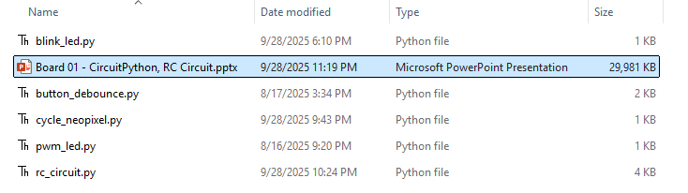
Open This Slide Deck
This is the Board 01 PowerPoint Deck
We are currently viewing slide #48

Slide 49
Board 01 – Goals
Compare and contrast a microcontroller unit (MCU) with a central processing unit (CPU)
Gain familiarity with the Raspberry Pi Pico board that uses an RP2040 MCU
Understand the value of Adafruit’s CircuitPython and its Blinka layer that runs on personal computers and SBCs
Review Adafruit’s u2if firmware that connects your PC to the RP2040 ports and protocols

Slide 50
Unpacking Your Student Kit A
Each student has a numbered “A” kit – record your kit ##
Gently open your kit then take a picture of it before unpacking it – please repackage it the same way
(4) Breadboards {Numbered 01, 02, 03, 04}
(1) Raspberry Pi Pico microcontroller
(1) Silver braided USB-A (Male) to USB-B Micro (Male) cable
(1) USB-A (Female) to USB-C (Male) adapter
(3) Black and (3) Red jumper cables (Male to Male)
(2) Yellow and (2) Blue jumper cables (Male to Male)
(1) 200 mm Qwiic / STEMMA QT cable (JST SH 4-Pin)

Slide 51
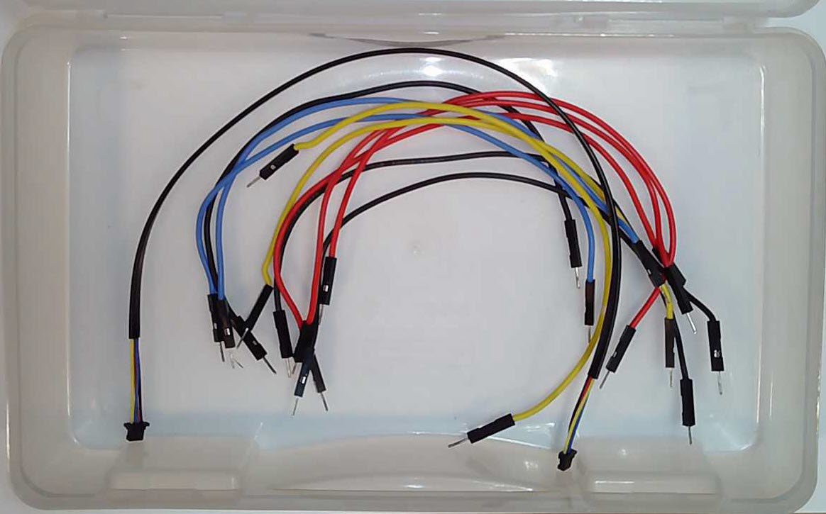
Unpacking Your Student Kit (A)
(1) Qwiic / STEMMA-QT
(3) Red
(3) Black
(2) Blue
(2) Yellow

Slide 52
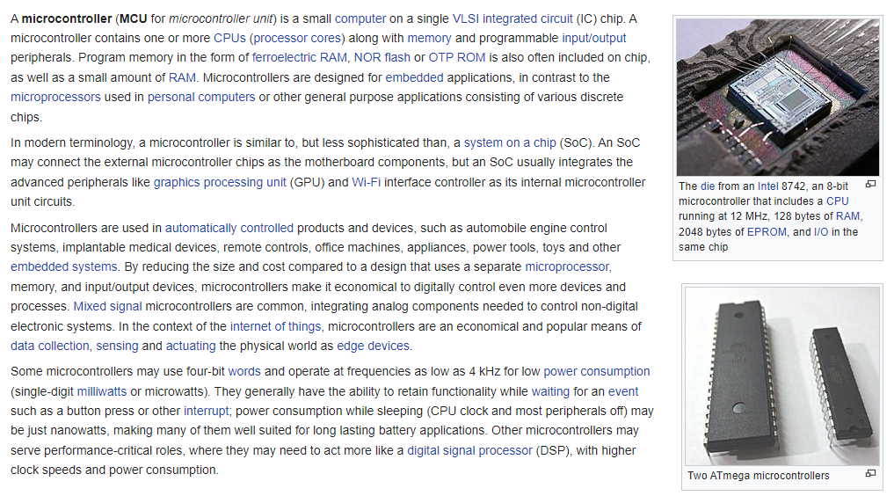
What is a Microcontroller Unit (MCU)?
https://en.wikipedia.org/wiki/Microcontroller

Slide 53
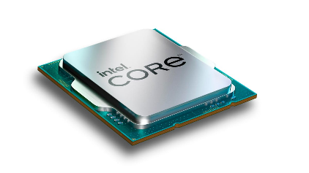
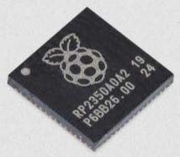
CPU vs MCU
Central Processing Unit (CPU)
Microcontroller Unit (MCU)
Runs many programs simultaneously
Large size (billions of transistors)
32+ execution Cores
Extremely high speed (+4GHz)
High Power Consumption
Large Addressable Memory (TB)
Advanced Mathematics Functions
Designed to run Operating Systems
Low Volume / High Cost
Often runs only a single program
Small size (thousands of transistors)
2 execution Cores
Generally Slower (133MHz)
Very Low Power Consumption
Smaller Addressable Memory (KB)
Simple Mathematics Functions
Often runs NO operating system
High Volume / Low Cost
Intel Core Ultra 9 = $589
Raspberry RP2040 = $0.80

Slide 54

What is a Microcontroller Unit (MCU)?

Slide 55


What is a Microcontroller Unit (MCU)?
https://www.raspberrypi.com/documentation/microcontrollers/silicon.html
Raspberry Pi Foundation
RP2040 MCU

Slide 56


https://www.adafruit.com/product/5525
$5.00

Slide 57


What is Adafruit?
$150M revenue in 2025
Earned her Masters Degree in Electrical Engineering from MIT

Slide 58



$4.50
https://www.adafruit.com/product/5905

Slide 59

Adafruit CircuitPython
https://circuitpython.org

Slide 60

Adafruit Blinka
https://circuitpython.org/blinka

Slide 61

Adafruit Blinka
https://circuitpython.org/blinka/raspberry_pi_pico

Slide 62
Adafruit Blinka
Adafruit Blinka allows you to run CircuitPython code directly on your PC
This contrasts with the standard Circuit Python setup:
Normally, the CircuitPython runtime is first installed on a microcontroller
Then you download and run a CircuitPython script directly on the microcontroller
With Blinka, you don’t have to download a Python script to the microcontroller – only your PC runs Python code
The Adafruit u2if firmware via the Blinka layer makes your PC “believe” it has GPIO pins, buses (such as Serial, SPI, I2C) and two ADC ports

Slide 63

Adafruit u2if Firmware
https://learn.adafruit.com/circuitpython-libraries-on-micropython-using-the-raspberry-pi-pico/running-circuitpython-code-without-circuitpython
u2if = USB to interfaces

Slide 64

Adafruit u2if Firmware Pinout
NOTE: I have already preloaded the latest version of the u2if firmware onto your Pi Pico

Slide 65
Wiring Each Board
The Pi Pico connects to your PC using the silver cord
The USB-A (Male) connector is inserted into your PC
The USB-B Micro (Male) is inserted into the Pi Pico
Please do not remove the Pi Pico from the Under Plate
If you incorrectly wire your lab, you can permanently damage your laptop’s USB port—double-check everything!
Connect the Pi Pico after you have connected all required silicon jumper wires (and the Qwiic cable if needed for the lab) to the components on the breadboard
NOTE: I have already preloaded the latest version of the u2if firmware onto your Pi Pico boards

Slide 66



Example Lab Wiring

Slide 67

Jumper Wires
https://www.adafruit.com/product/4482

Slide 68

Jumper Wires
https://www.amazon.com/gp/product/B0002H7AIG

Slide 69



https://www.adafruit.com/product/4401
$1.25
STEMMA QT / Qwiic Cable – 200mm

Slide 70
Board 01 – Goals (cont.)
Develop intuition about the relationships between voltage, current, resistance, and power
Map the power rails and tie point rows on a breadboard to the underlying wiring connectivity
Learn what a Digital Multimeter (DMM) is and how it compares to the capabilities of a Multi-function Tester
Review standard analog discrete components, including a resistor, a capacitor, and a light-emitting diode
Run CircuitPython code via Blinka to drive an LED using pulse width modulation (PWM)

Slide 71



What is a Current?
Actual Current Flows from - to +
Conventional Current Flows from + to -
Current = Moving Electrons

Slide 72






Voltage, Current, Resistance
Potential Energy
Amount
of Flow
V = Voltage
Volts (V)
I = Current
Amps (A)
R = Resistance
Ohms ($Ω$)
Alessandro Volta
(1745 – 1827)
André Ampère
(1775 – 1836)
Georg Ohm
(1789 – 1854)

Slide 73

Voltage, Current, Resistance

Slide 74





Voltage, Current, Resistance
Current
Ohm's Law
Volts
Resistance
$$V=IR$$
A Circuit
Schematic
James Watt
(1736 – 1819)
Joules (Energy) per second

Slide 75






Voltage, Current, Resistance
$$P=\frac{V^{2}}{R}$$
$$\frac{{(5V)}^{2}}{.05Ω}=500W$$
All metal wires have some
(a very tiny amount) of
natural internal resistance!
If resistance is low,
and voltage is high,
a current can generate
a lot of HEAT (Watts)

Slide 76


Voltage, Current, Resistance
SAFETY First!
Pay strict attention to wiring pictures and schematics
Do not cross +V and GND wires
All team members must doublecheck each other's circuits prior to turning on the power
Unplug any circuit that is getting hot – do not touch the board!
Completely unplug every circuit prior to changing any wiring
Immediately report any problems

Slide 77


Breadboard Wiring
+V
GND
The holes along each outside vertical column are electrically connected and are called a power rail or a power bus
In direct current (DC) circuits, positive voltage (+V, V_{CC} , V_{DD}) is usually colored RED
It is common in direct current circuits to connect a negative terminal to Ground (GND)
In direct current (DC) circuits, the “zero reference” voltage (GND, COM, V_{SS}) is usually colored BLACK or BLUE

Slide 78

Breadboard Wiring
+V
GND
The holes along each outside vertical column are electrically connected and are called a power rail or a power bus
In direct current (DC) circuits, positive voltage (+V, V_{CC} , V_{DD}) is usually colored RED
In direct current (DC) circuits, the “zero reference” voltage (GND, COM, V_{SS}) is usually colored BLACK or BLUE

Slide 79

Breadboard Wiring
Rows of five holes (tie-points) on either side of the middle
(DIP Support) channel are electrically connected
These two wirings accomplish the same thing
All three of these wires are electrically connected

Slide 80


Breadboard Wiring

Slide 81

Test Your Understanding
+5V
GND
①
+5V
②
What is the voltage at the free end of each of these wires?
GND
③
+3.3V
④
⑤
Meltdown
A short circuit!
+3.3V
GND
GND

Slide 82

Review Board 01
Board 01 will introduce you to simple GPIO coding by flashing an external LED, driving a NeoPixel, reading the status of a push button, and measuring a series RC circuit
LED
①
NeoPixel
②
Push Button
③
RC Circuit
④

Slide 83


What is a Resistor?
A resistor is a passive two-terminal electrical component that implements electrical resistance as a circuit element. In electronic circuits, resistors are used to reduce current flow, adjust signal levels, to divide voltages, and bias active elements
The electrical function of a resistor is specified by its resistance: common commercial resistors are manufactured over a range of more than nine orders of magnitude. The nominal value of the resistance falls within the manufacturing tolerance, indicated on the component
½ Watt Resistors
1% Tolerance

Slide 84


What is a Digital Multimeter (DMM)?
A DMM is a standard test and measurement instrument used by engineers and technicians to measure multiple electrical stimuli, including voltage, current and resistance
It combines the features of a voltmeter, ammeter and ohmmeter, and is used to verify the state of a system or circuit for safety purposes
V
Ω
-||-
= Measure voltage (volts)
= Measure resistance (ohms)
= Measure capacitance (farads)
Turn the dial to select the measurement you want to take for the component attached to the DMM leads
BLACK
RED

Slide 85

Measuring a Resistor with a DMM
Turn the dial to Ω to measure in ohms the resistor

Slide 86





Measuring a Resistor with a DMM
$k$= "kilo-"
is one thousand
$M$= "mega-"
is one million
$$1 kΩ={10}^{3} Ω$$
$$1 MΩ={10}^{6} Ω$$
The units might be difficult to see – here the measurement is 10.02 kiloohms $\left(kΩ\right)$

Slide 87

Purchase a Digital Multimeter (DMM)
https://www.sparkfun.com/products/18340

Slide 88


What is a Diode?
A diode is a semiconductor device that essentially acts as a one-way switch for current. It allows current to flow easily in one direction, but severely restricts current from flowing in the opposite direction
The forward voltage (Vf) is the amount of voltage needed to get current to flow across a diode. This is important to know because if you are trying to push a signal through a diode that is less than the forward voltage, you will be disappointed
Anode
+
Cathode
-
1N4001 Diode

Slide 89

Measuring a Diode with T7 Tester
The Vf value is displayed on the screen
Press the Start button to begin measuring the DIODE values

Slide 90

Purchase a T7 Tester
https://www.amazon.com/gp/product/B09KGXTVBR

Slide 91
What is a Light Emitting Diode
In a diode, there is a PN junction, where P-type semiconductor material (with electron “holes”) touches N-type semiconductor material (with excess electrons)
When current is applied in the forward direction, electrons from the N-type material are pushed toward the junction. Simultaneously, “holes” from the P-type material move toward the junction from the opposite direction
At the junction, electrons from the conduction band (higher energy) recombine with holes in the valence band (lower energy). This recombination releases energy as photons (light) rather than heat, making the process highly efficient

Slide 92

What is a Light Emitting Diode?

Slide 93

Wire Your Pico to Board 01
Black to GND
Don’t move short jumper wires
Yellow to (GP)IO22 pin
NEVER remove components from any breadboard

Slide 94
Wire Your Pico to Board 01
Black to GND
A circuit must have a closed loop for electrons to flow, enabling a current
Yellow to (GP)IO22 pin

Slide 95
Wire Your Pico to Board 01
Black to GND
A 330Ω Resistor limits the current flowing through the LED so it doesn’t burn out
Yellow to (GP)IO22 pin

Slide 96

Wire Your Pico to Board 01
Point the silver part of the jumper wire pin towards you

Slide 97

Open blink_led.py
①
②
③
④
⑤
⑥

Slide 98

Connect the Pico to your PC
Plug the USB connector into your PC

Slide 99
Run blink_led.py
What is happening to the LED and why?

Slide 100
Dimming an LED via PWM
To dim an LED, we need to provide a variable voltage to the diode between 0V and 3.3V
An RP2040 microcontroller can output only a fixed 3.3V
However, we can simulate a variable output voltage by using pulse width modulation (PWM)
PWM turns a GPIO output pin quickly on and off, and the resulting average voltage (over some unit of time) is what appears to drive the attached component
The ratio of time the GPIO pin is High vs. Low (the duty cycle) determines the perceived fractional output voltage

Slide 101


Dimming an LED via PWM

Slide 102

Open pwm_led.py
①
②
In Hz, for a full cycle
③
④
⑤
/ 65535 yields (0 – 100)%
⑥
⑦

Slide 103
Run pwm_led.py
What is happening to the LED and why?

Slide 104
Board 01 – Goals (cont.)
Control an Adafruit NeoPixel to emit different colors
Use a debounce library to simplify avoiding the electrical noise (jitter) coming from a low-cost push button
Compare and contrast an Analog to Digital Converter (ADC) versus a Digital to Analog Converter (DAC)
Understand Kirchhoff's two Circuit Laws (KCL + KVL)
Derive and solve a differential equation expressing the voltage over time of an RC circuit as it charges
Graph the circuit response of a resistor and a capacitor connected in series to compare the theoretical vs. actual voltage over time

Slide 105

Adafruit made NeoPixels fun!
https://www.adafruit.com/category/168
In 2007, the WorldSemi company created the WS2812-compatible family of addressable color LEDs
In 2013, Limor Fried (founder of Adafruit, also goes by Ladyada) branded these RGB LEDs as NeoPixels and provided extensive documentation, libraries, and support for these LEDs, making them a staple in the maker and DIY electronics community

Slide 106
Unplug the MCU before changing any wiring!
As we move between each “experiment” on a given breadboard, or when we switch to an entirely new Board #, it is crucial that your FIRST UNPLUG the USB cord!
I recommend unplugging the cord at the PC end – leave the cord connected to the Micro USB port on the Pico
It is dangerous to change any wiring while the MCU is still drawing power from your laptop’s USB port
If you incorrectly connect a jumper wire between the Pico and the breadboard while the Pico is drawing power from your PC, you can permanently damage your PC’s USB port
Have your partner double-check your wiring every step!

Slide 107

Wire Your Pico to Board 01
Black to GND
Red to 3.3V
Yellow to (GP)IO22 pin

Slide 108
Wire Your Pico to Board 01
Black to GND
Red to 3.3V
Only one control wire is required!
Yellow to (GP)IO22 pin

Slide 109

Open cycle_neopixel.py
①
②
③
④
⑤
⑥
⑦
⑧
⑨
⑩

Slide 110

Connect the Pico to Your PC
Plug the USB connector into your PC

Slide 111
Run cycle_neopixel.py
Check out the NeoPixel on your Board 01

Slide 112
Unplug the MCU before changing any wiring!
As we move between each “experiment” on a given breadboard, or when we switch to an entirely new Board #, it is crucial that your FIRST UNPLUG the USB cord!
I recommend unplugging the cord at the PC end – leave the cord connected to the Micro USB port on the Pico
It is dangerous to change any wiring while the MCU is still drawing power from your laptop’s USB port
If you incorrectly connect a jumper wire between the Pico and the breadboard while the Pico is drawing power from your PC, you can permanently damage your PC’s USB port
Have your partner double-check your wiring every step!

Slide 113

Wire Your Pico to Board 01
Black to GND
Red to 3.3V
This button is NORMALLY OPEN
Blue to
(GP)IO20 pin
The code will set
GPIO Pin #20
to be in a PULL-UP mode

Slide 114

General Purpose I/O Pins (GPIO)
+3.3V
An internal pull-up resistor inside the RP2040 will keep the GPIO input from floating while the button is normally open
We can consider this configuration to be ACTIVE LOW
This means when the GPIO pin goes LOW
(to GND or 0 Volts)
it indicates the user pressed the button
When the button is pressed, the path of least resistance connects the GPIO to GND

Slide 115

The Real World is Noisy
https://learn.adafruit.com/debouncer-library-python-circuitpython-buttons-sensors

Slide 116

Open button_debounce.py
①
②
③
④
⑤
⑥

Slide 117

View button_debounce.py
①
②
③
④
⑤
⑥
⑦

Slide 118

Connect the Pico to Your PC
Plug the USB connector into your PC

Slide 119
Run button_debounce.py
Press the push button repeatedly – what does the NeoPixel do?

Slide 120
Review Board 01
We will now analyze the final circuit on Board 01, which is a series Resistor-Capacitor (RC) circuit

Slide 121



What is a Capacitor?
A capacitor is a device that stores electrical energy in the electric field by virtue of accumulating electric charges on two close surfaces insulated from each other
The primary function of capacitors is to store electrostatic energy in an electric field and give this energy back to the circuit when necessary

Slide 122




Ceramic vs. Electrolytic Capacitors
The longer lead is usually the anode (+)
The shorter lead is usually the cathode (-)

Slide 123


Measuring Electrolytic Capacitor with a DMM
Turn the dial to -||- to measure in farads the electrolytic capacitor
$$1 mF=1×{10}^{−3}F$$
$$1 μF=1×{10}^{−6}F$$
$$1 nF=1×{10}^{−9}F$$
$$1 pF=1×{10}^{−12}F$$

Slide 124



Measuring Electrolytic Capacitor with a DMM
$$1 μF=0.001 mF$$
$$1 nF=0.001 μF$$
$$1 pF=0.001 nF$$
The units might be difficult to see – here the measurement is 10.98 microfarads $\left(μF\right)$

Slide 125

ADC (input) vs. DAC (output)
ADC = Analog to Digital Converter
Reads a voltage between +3.3V to GND and returns an integer between 0-65,535:
65,535 = +3.3V, 0 = GND
DAC = Digital to Analog Converter
Given an integer between 0 and 65,535 the MCU outputs a fixed voltage:
65,535 = +3.3V, 0 = GND
RP2040 can sense only 4,096 distinct voltage levels
The RP2040 does NOT have a true DAC
(Using PWM is an unstable approximation)

Slide 126



Kirchhoff's Current Law (KCL)
The sum of all currents entering a node equals the currents leaving the node
$$I_{1}+I_{2}+I_{3}=I_{4}+I_{5}$$
Gustav Kirchhoff
(1824-1887)
Conservation of Charge

Slide 127

Kirchhoff's Voltage Law (KVL)
The sum of all voltages around a closed loop is zero
Conservation of Energy

Slide 128











Series Resistor-Capacitor (RC) Circuit
$$V_{S}=RC\frac{dv_{C}}{dt}+v_{C}$$
R
$$\frac{dv_{C}}{dt}=\frac{V_{S}−v_{C}}{RC}$$
V_{S}
C
$$\frac{dv_{C}}{V_{S}−v_{C}}=\frac{1}{RC}dt$$
$$\int_{0}^{v_{c}}{\frac{dv_{C}}{V_{S}−v_{C}}}=\int_{0}^{t}{\frac{1}{RC}dt}$$
$$V_{s}=v_{R}+v_{C}$$
KVL
$$v_{R}=i_{R}R$$
Ohm's Law
$$\ln\left(V_{S}\right)−\ln\left(−{v_{C}+V}_{S}\right)=\frac{t}{RC}$$
$$i_{R}=i_{C}$$
KCL
$$i_{C}=C\frac{dv_{C}}{dt}$$
Capacitive Current
$$\ln\left(V_{S}−v_{C}\right)−\ln\left(V_{S}\right)=\frac{−t}{RC}$$

Slide 129







Series Resistor-Capacitor (RC) Circuit
$$\ln\left(V_{S}−v_{C}\right)−\ln\left(V_{S}\right)=\frac{−t}{RC}$$
$$\ln\left(\frac{V_{S}−v_{C}}{V_{S}}\right)=\frac{−t}{RC}$$
R
V_{S}
$$\frac{V_{S}−v_{C}}{V_{S}}=e^{{−t}/{RC}}$$
C
$$V_{S}−v_{C}=V_{S}\left(e^{{−t}/{RC}}\right)$$
$$−v_{C}=V_{S}\left(e^{{−t}/{RC}}\right)−V_{S}$$
$$V_{s}=v_{R}+v_{C}$$
KVL
Ohm's Law
$$v_{C}=V_{S}−V_{S}\left(e^{{−t}/{RC}}\right)$$
$$v_{R}=i_{R}R$$
$$i_{R}=i_{C}$$
KCL
$$v_{c}=V_{s}\left(1−e^{{−t}/{RC}}\right)$$
$$i_{C}=C\frac{dv_{C}}{dt}$$
Capacitive Current
The voltage across the charging capacitor as a function of time

Slide 130
Unplug the MCU before changing any wiring!
As we move between each “experiment” on a given breadboard, or when we switch to an entirely new Board #, it is crucial that your FIRST UNPLUG the USB cord!
I recommend unplugging the cord at the PC end – leave the cord connected to the Micro USB port on the Pico
It is dangerous to change any wiring while the MCU is still drawing power from your laptop’s USB port
If you incorrectly connect a jumper wire between the Pico and the breadboard while the Pico is drawing power from your PC, you can permanently damage your PC’s USB port
Have your partner double-check your wiring every step!

Slide 131

Wire Your Pico to Board 01
Black to GND
Yellow to (GP)IO22 pin
Blue to AD1 pin

Slide 132

Wire Your Pico to Board 01

Slide 133

Open rc_circuit.py
①
②
③
④

Slide 134

Extending Python via the numpy Package
https://numpy.org

Slide 135

https://matplotlib.org

Slide 136

About PyPI (Python Package Index)
https://pypi.org

Slide 137

View rc_circuit.py
①
②
③
④
⑤
⑥
⑦
⑧
Taqaddum
Arabic word meaning “progress”
⑨
⑩

Slide 138

View rc_circuit.py
①
②
③
④
⑤
⑥
⑦
⑧
⑨

Slide 139

View rc_circuit.py
①
②
③
④
⑤
⑥

Slide 140

View rc_circuit.py
①
②
③
④

Slide 141

Connect the Pico to Your PC
Plug the USB connector into your PC

Slide 142

Run rc_circuit.py

Slide 143

Run rc_circuit.py

Slide 144



Check rc_circuit.py
$$v_{c}=V_{s}\left(e^{{−t}/{RC}}\right)$$

Slide 145

$$τ=RC=\left(10,000Ω\right)\left(1×{10}^{−5}F\right)=100ms=1T (time constant)$$
$1τ=63.2\% of V_{In}=\left(3.3\right)\left(0.632\right)=2.06V$
✓

Slide 146
$$τ=RC=\left(10,000Ω\right)\left(1×{10}^{−5}F\right)=100ms=1T (time constant)$$
$3.3V−1T=3.3V−63.2\% of V_{In}=\left(3.3V\right)\left(1−0.632\right)=1.22V$
✓

Slide 147
Check rc_circuit.py
Did your actual precisely match theory? Why not?

Slide 148






The Value of Knowing How to Code
$$\$450 Oscilloscope$$
$$\$5 MCU$$

Slide 149
Installing Software (Manually)

Slide 150


Manually Update winget (only if necessary)
https://apps.microsoft.com/detail/9NBLGGH4NNS1
https://apps.microsoft.com/detail/9N0DX20HK701
https://github.com/PowerShell/PowerShell/releases

Slide 151

Manually install VS Code (only if necessary)
https://code.visualstudio.com/download

Slide 152

Manually install Git (only if necessary)
https://git-scm.com/install/windows

Slide 153


Manually install Astral “uv” (only if necessary)
powershell -ExecutionPolicy ByPass -c "irm https://astral.sh/uv/install.ps1 | iex"
Installing uv on Windows
https://docs.astral.sh/uv/getting-started

